Slide 1
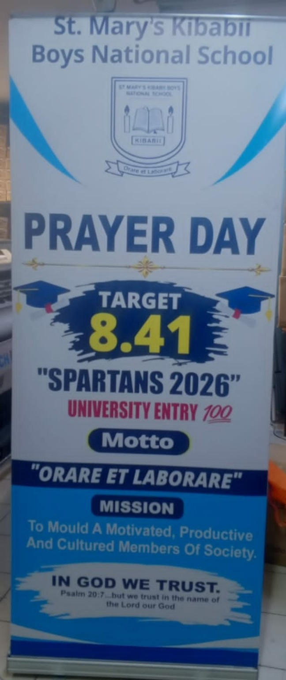
ST. MARY'S KIBABII BOYS
NATIONAL SCHOOL
PRAYER DAY 2026
22.09.2026
"SPARTANS 2026"
In God We Trust
University Transition • 100%

Slide 2

SPARTANS 2026
Our KCSE target
8.41
KCSE TARGET
B−

Slide 3
THE PRAYER DAY
A day of faith, focus and commitment
22 SEPTEMBER 2026
We gather in prayer as we prepare for the KCSE journey.
"In God We Trust"
— Spartans 2026 —

Slide 4
HOLY MASS
Celebrating faith and seeking God's guidance
Mass to be presided over by
HIS LORDSHIP
REV. BISHOP MARK KADIMA
Catholic Diocese of Bungoma
Prayer • Blessing • Thanksgiving • Hope

Slide 5
OUR SLOGAN
The goal beyond KCSE
💯
UNIVERSITY
TRANSITION
Every Spartan focused. Every Spartan progressing.
TARGET 8.41 • B− • UNIVERSITY ENTRY
In God We Trust

Slide 6
PARENTS & GUARDIANS
Follow the event from wherever you are
THE EVENT WILL BE LIVE
Parents and guardians will be able to follow the Prayer Day online.
📺 LIVE COVERAGE
22.09.2026

Slide 7
SPARTANS 2026
8.41 • B−
💯 UNIVERSITY TRANSITION
22.09.2026
"IN GOD WE TRUST"
St. Mary's Kibabii Boys National School

